Slide 1

CSE-326 PROJECT REPORT WEBSITE CREATION – UNIVERSITY MANAGEMENT SYSTEM(UMS)
COMPUTER SCIENCE AND ENGINEERING
SUBMITTED BY : FAISAL MOHAMMAD NAIK(12221940)
AMSHU GANNU(12223055)
SHASHANK DYDA(12220356)
SUBMITTED TO: MIR SALIM UL ISLAM (28897)
LOVELY PROFESSIONAL UNIVERSITY PUNJAB

Slide 3
CSE-326 PROJECT REPORT WEBSITE CREATION – UNIVERSITY MANAGEMENT SYSTEM(UMS)
COMPUTER SCIENCE AND ENGINEERING
SUBMITTED BY : FAISAL MOHAMMAD NAIK(12221940)
AMSHU GANNU(12223055)
SHASHANK DYDA(12220356)
SUBMITTED TO: MIR SALIM UL ISLAM (28897)
LOVELY PROFESSIONAL UNIVERSITY PUNJAB

Slide 4
INTRODUCTION TO PROJECT :
We have created this university management system(UMS) using HTML and CSS languages and it’s a good website and also we have attached source code and screen shots of our pages of website
We have mainly created two sections of web site login page and master page.
We have mostly used div tags and added web pages and images with the help of image tags to our website besides, that almost every tag and every css function is used in our web page
We have linked some sections through inline css and some through href attribute
We have styled our website through css and html and fonts and added colors and backgrounds to our website also.
We have also used borders,padding to make it more visible

Slide 5
FEATURES :
The main feature of the project is providing user an easy way to acess login page through that user can enter details and go master page.Through master user can easily access academic details,syllabus,attendance percentage,announcements,events etc
User can also get fee details and also user can get information about teachers on leave
We have also added navigation bar like features
And important details like student profile and attendance percentage
Also user can change password and form a new password

Slide 6
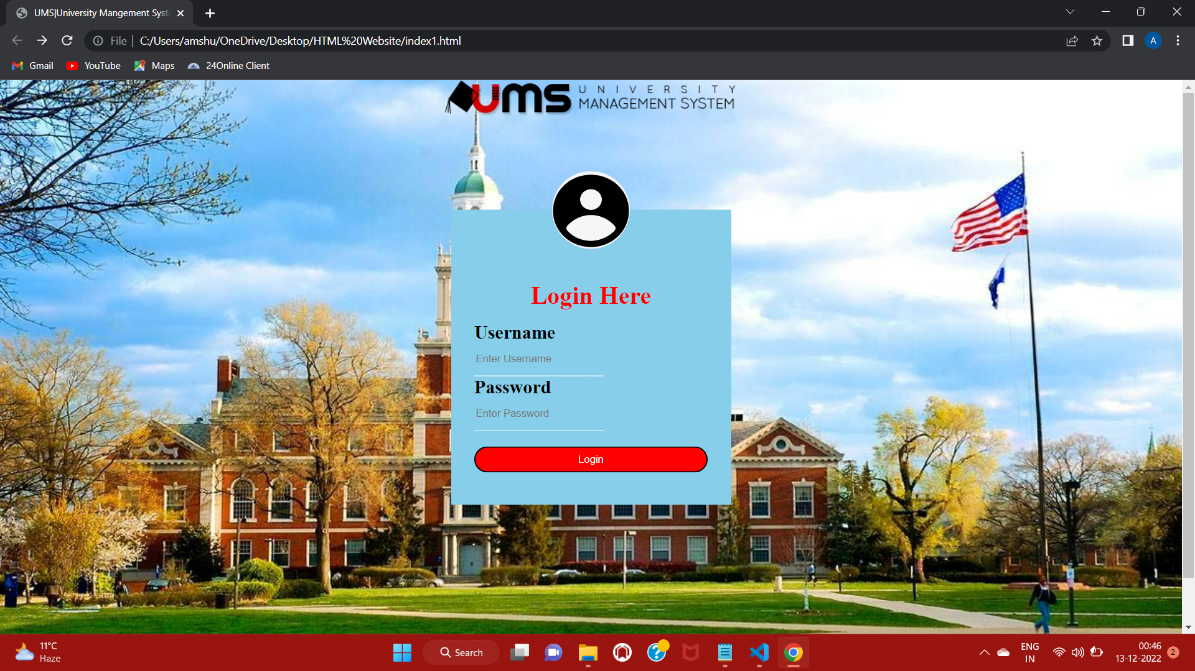

Slide 7
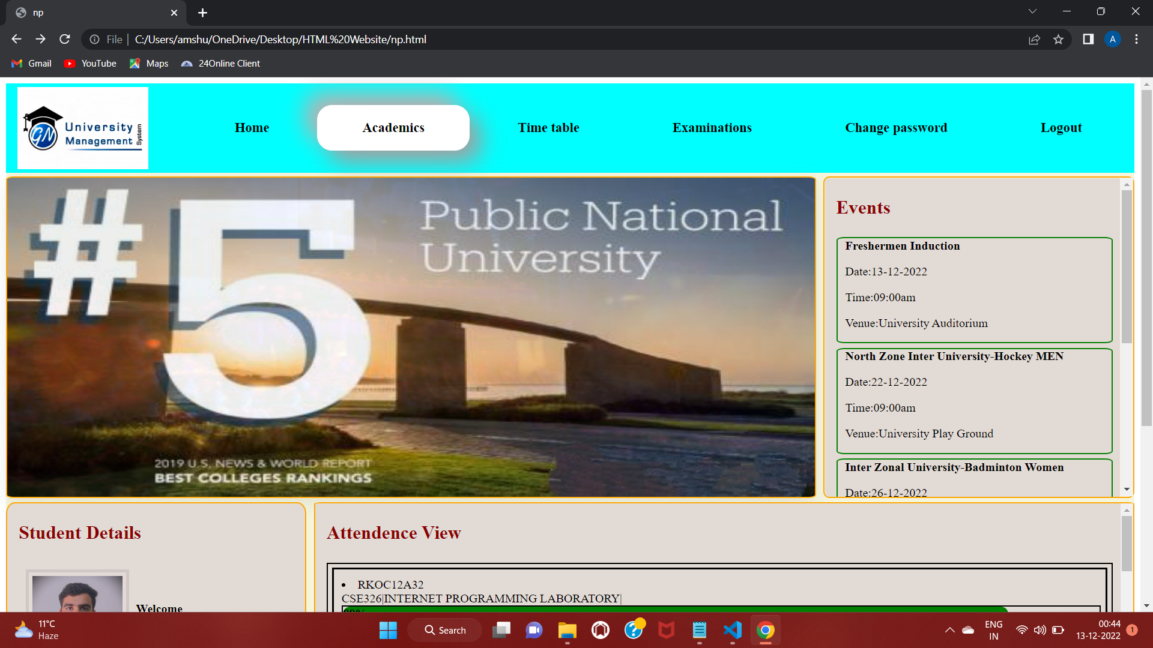

Slide 8
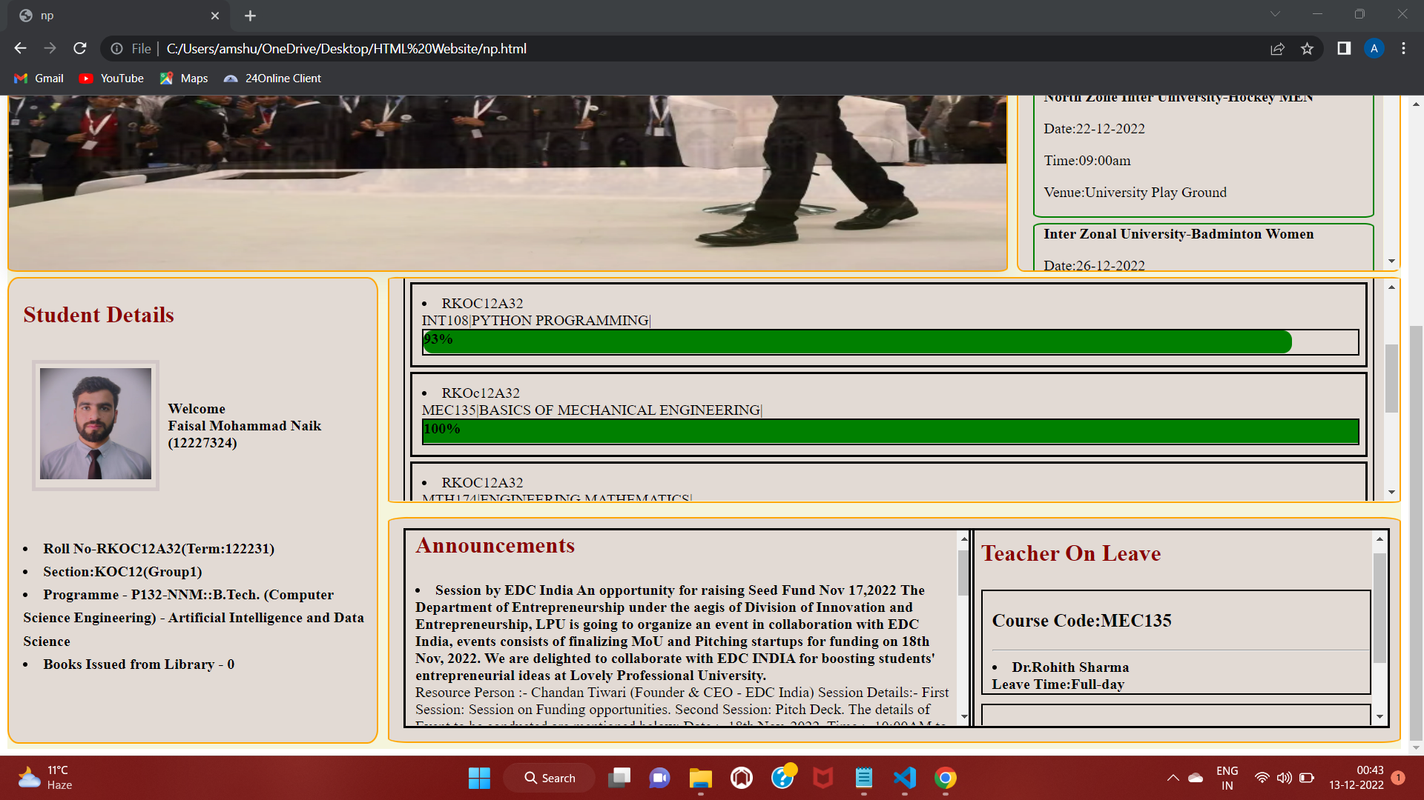

Slide 9
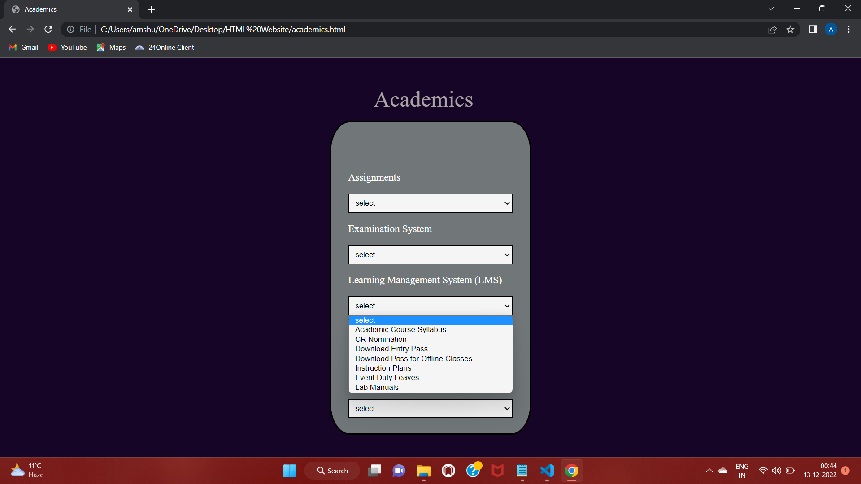

Slide 10
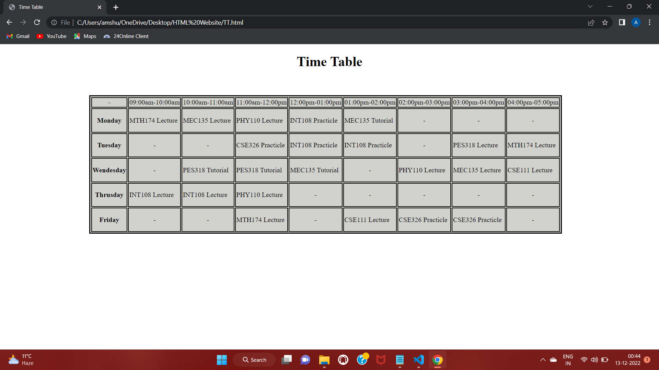

Slide 11
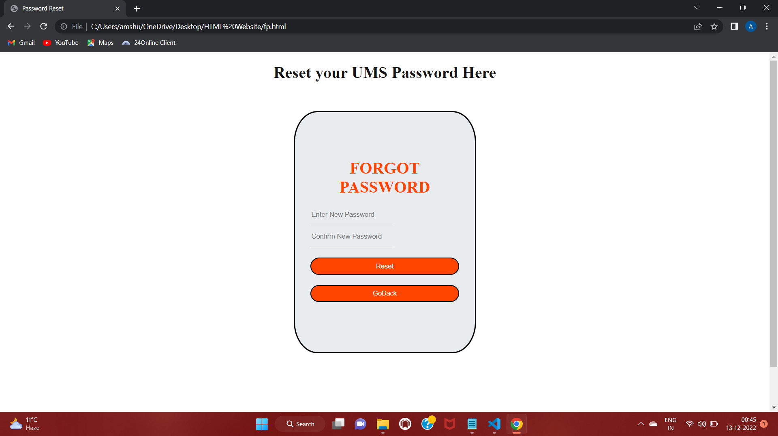

Slide 12
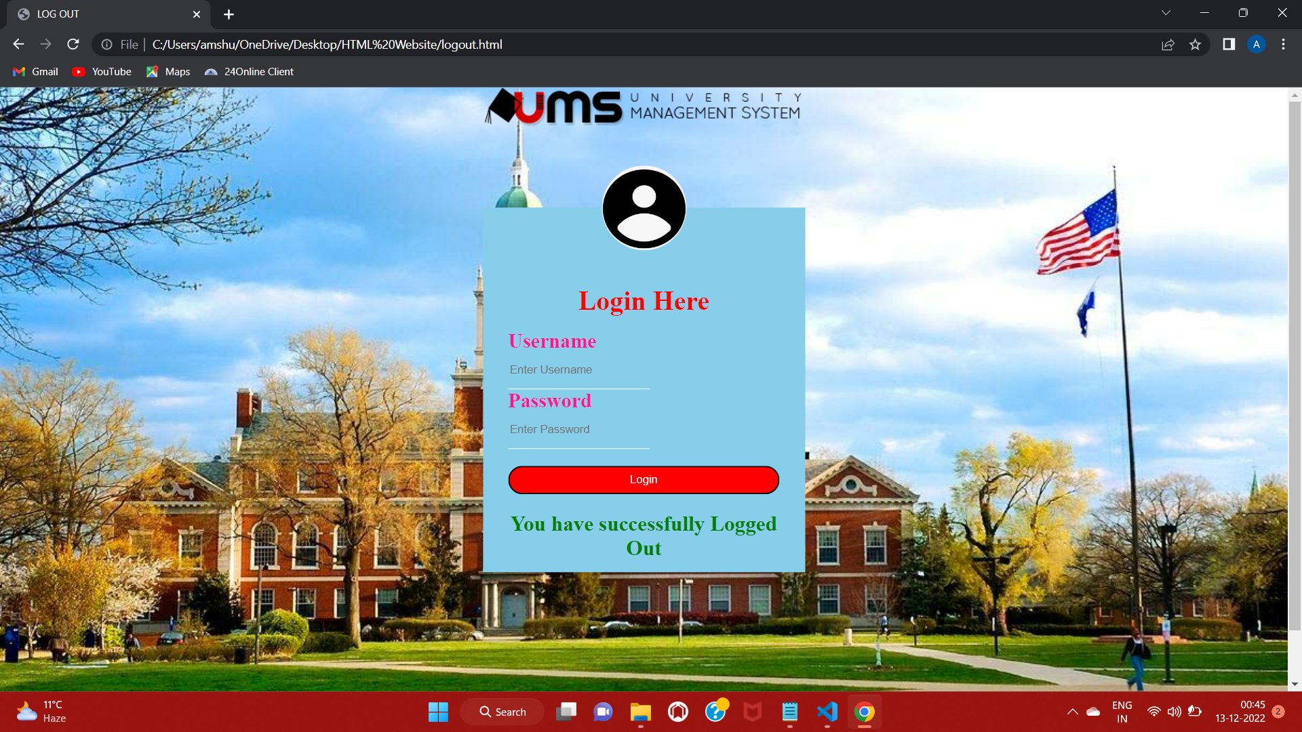

Slide 13
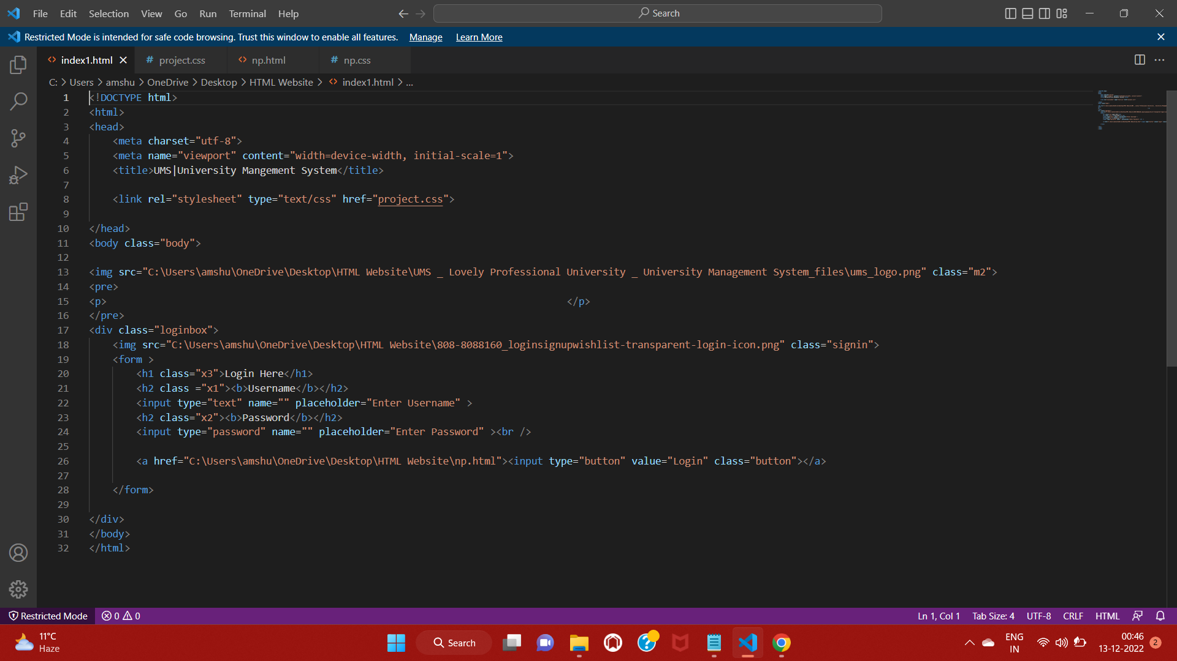

Slide 14
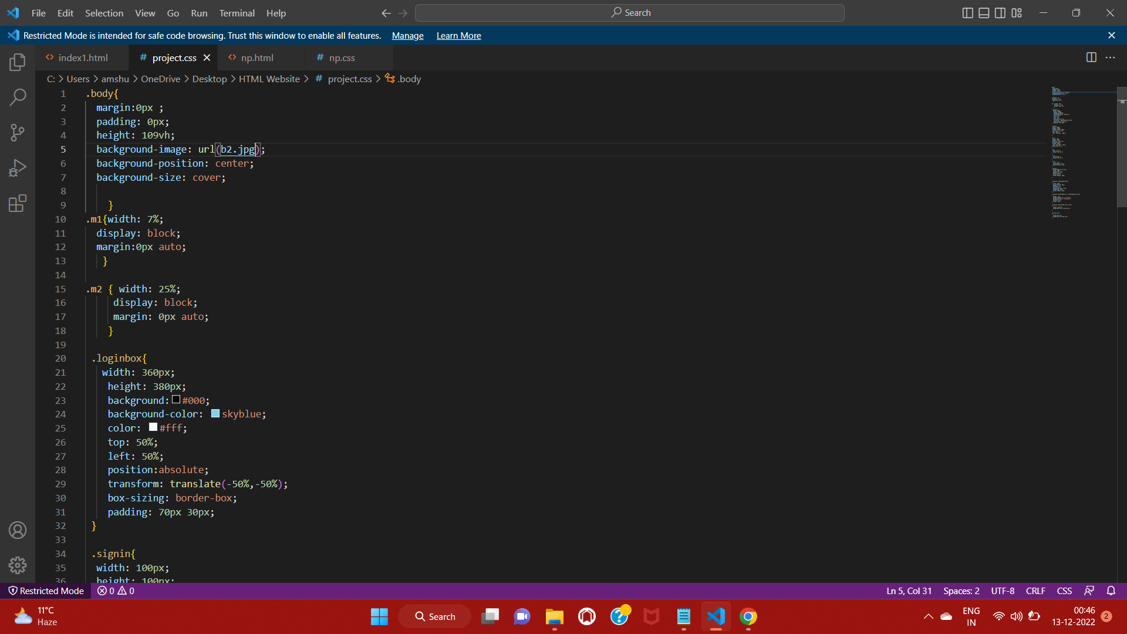

Slide 15
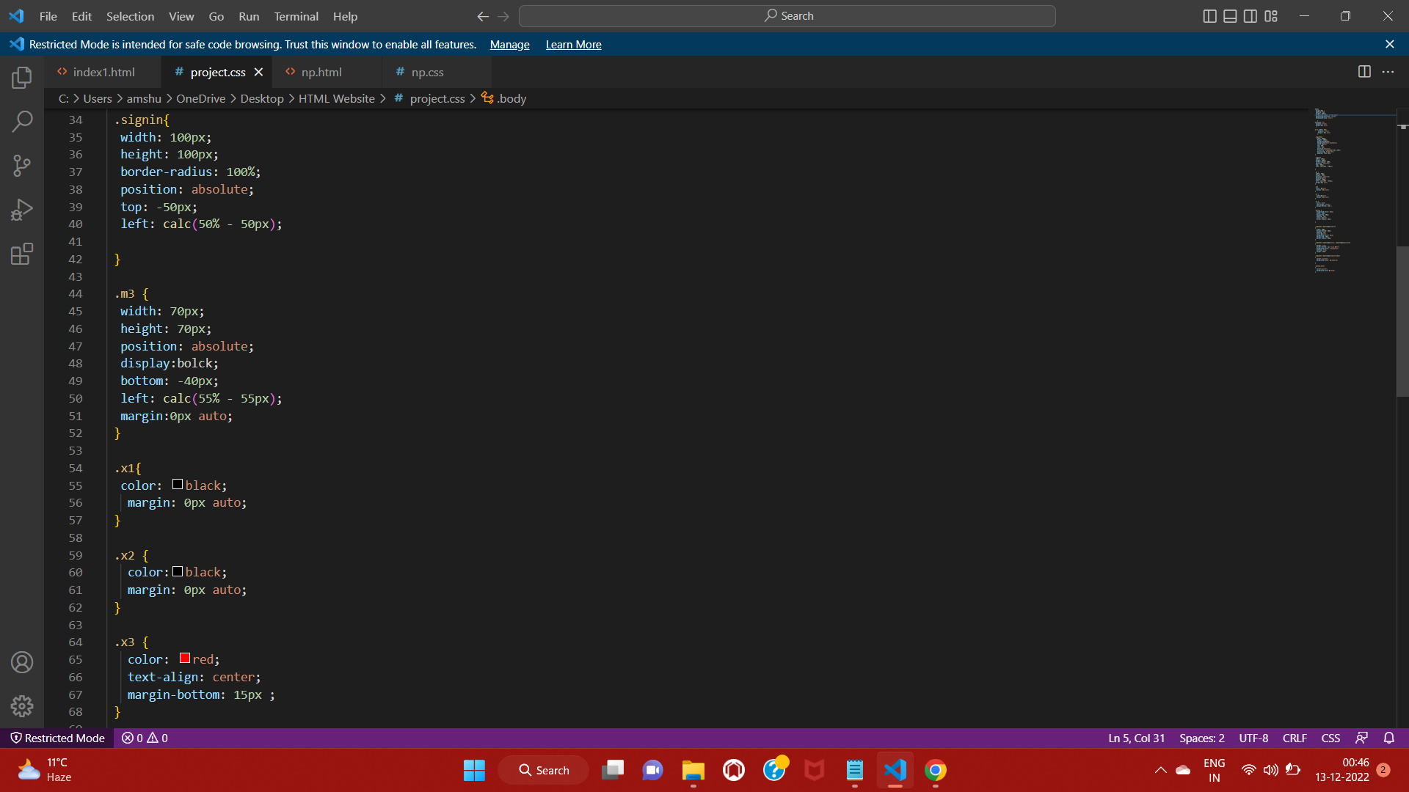

Slide 16
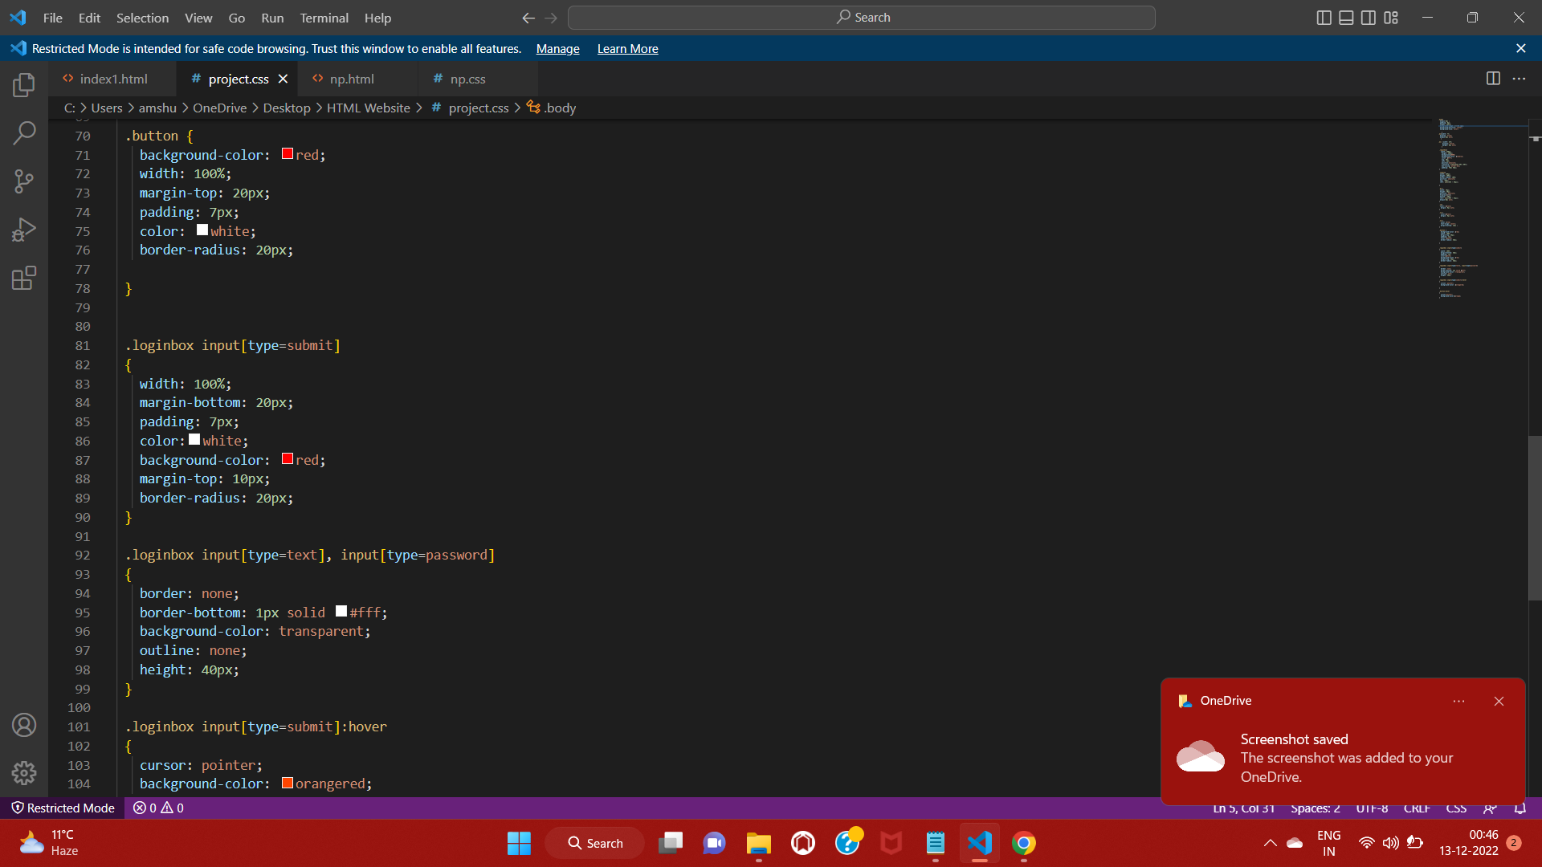

Slide 17
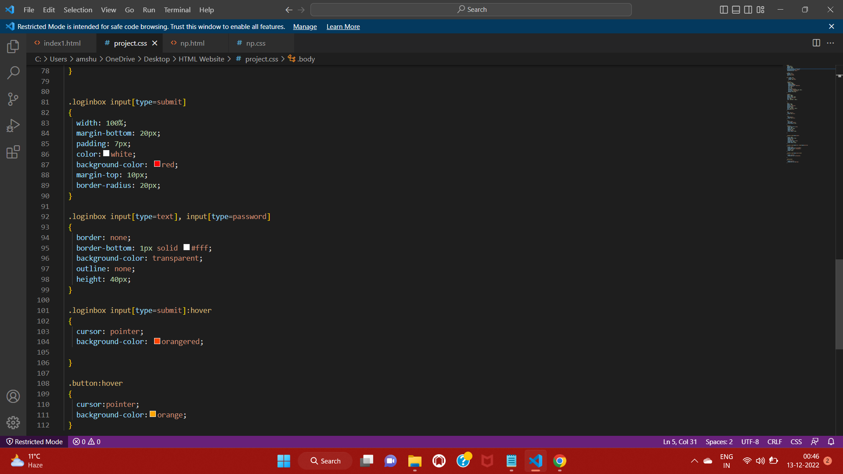
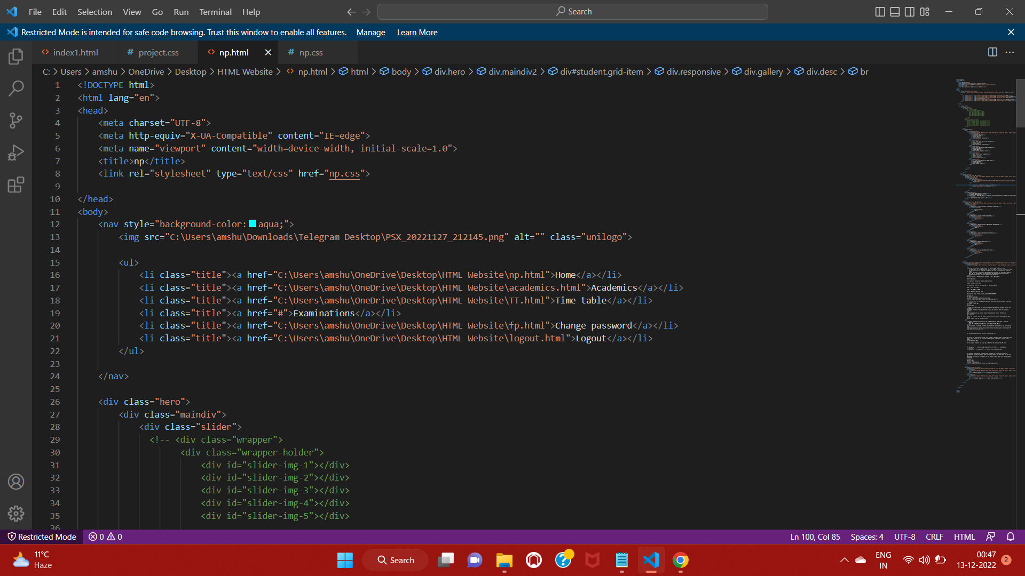
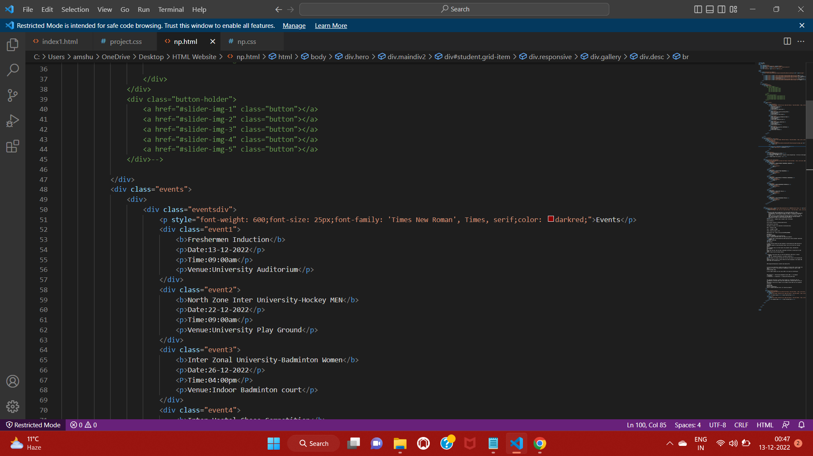

Slide 18
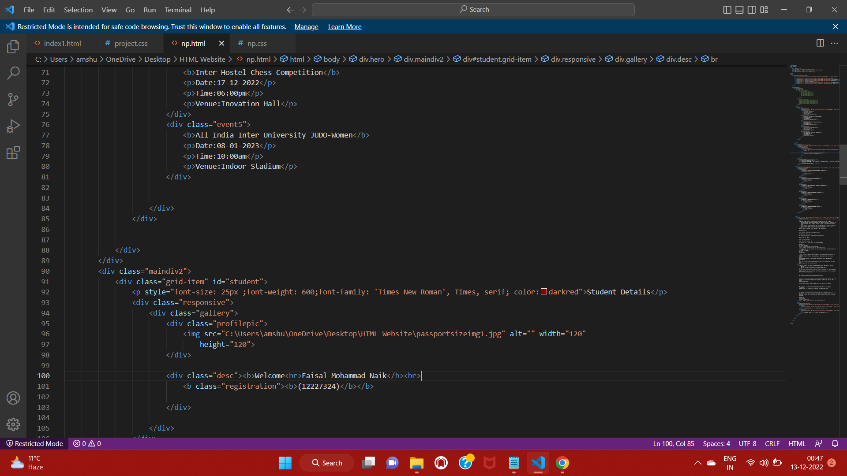

Slide 19
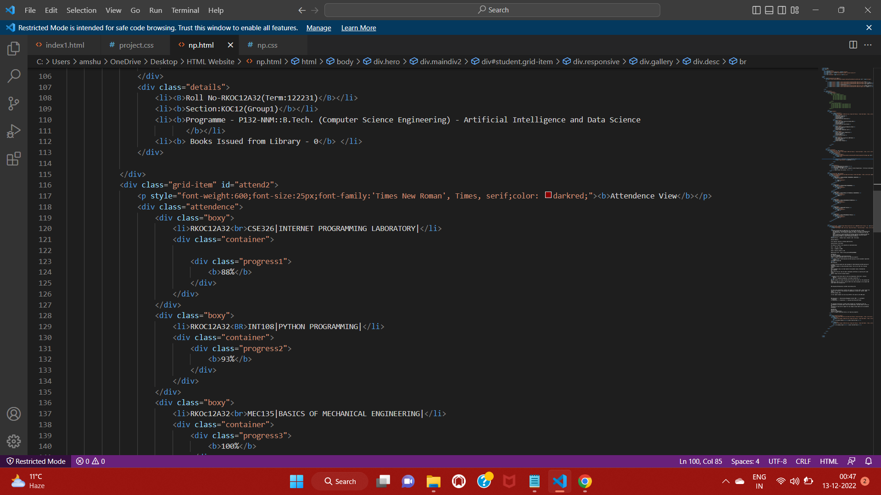

Slide 20
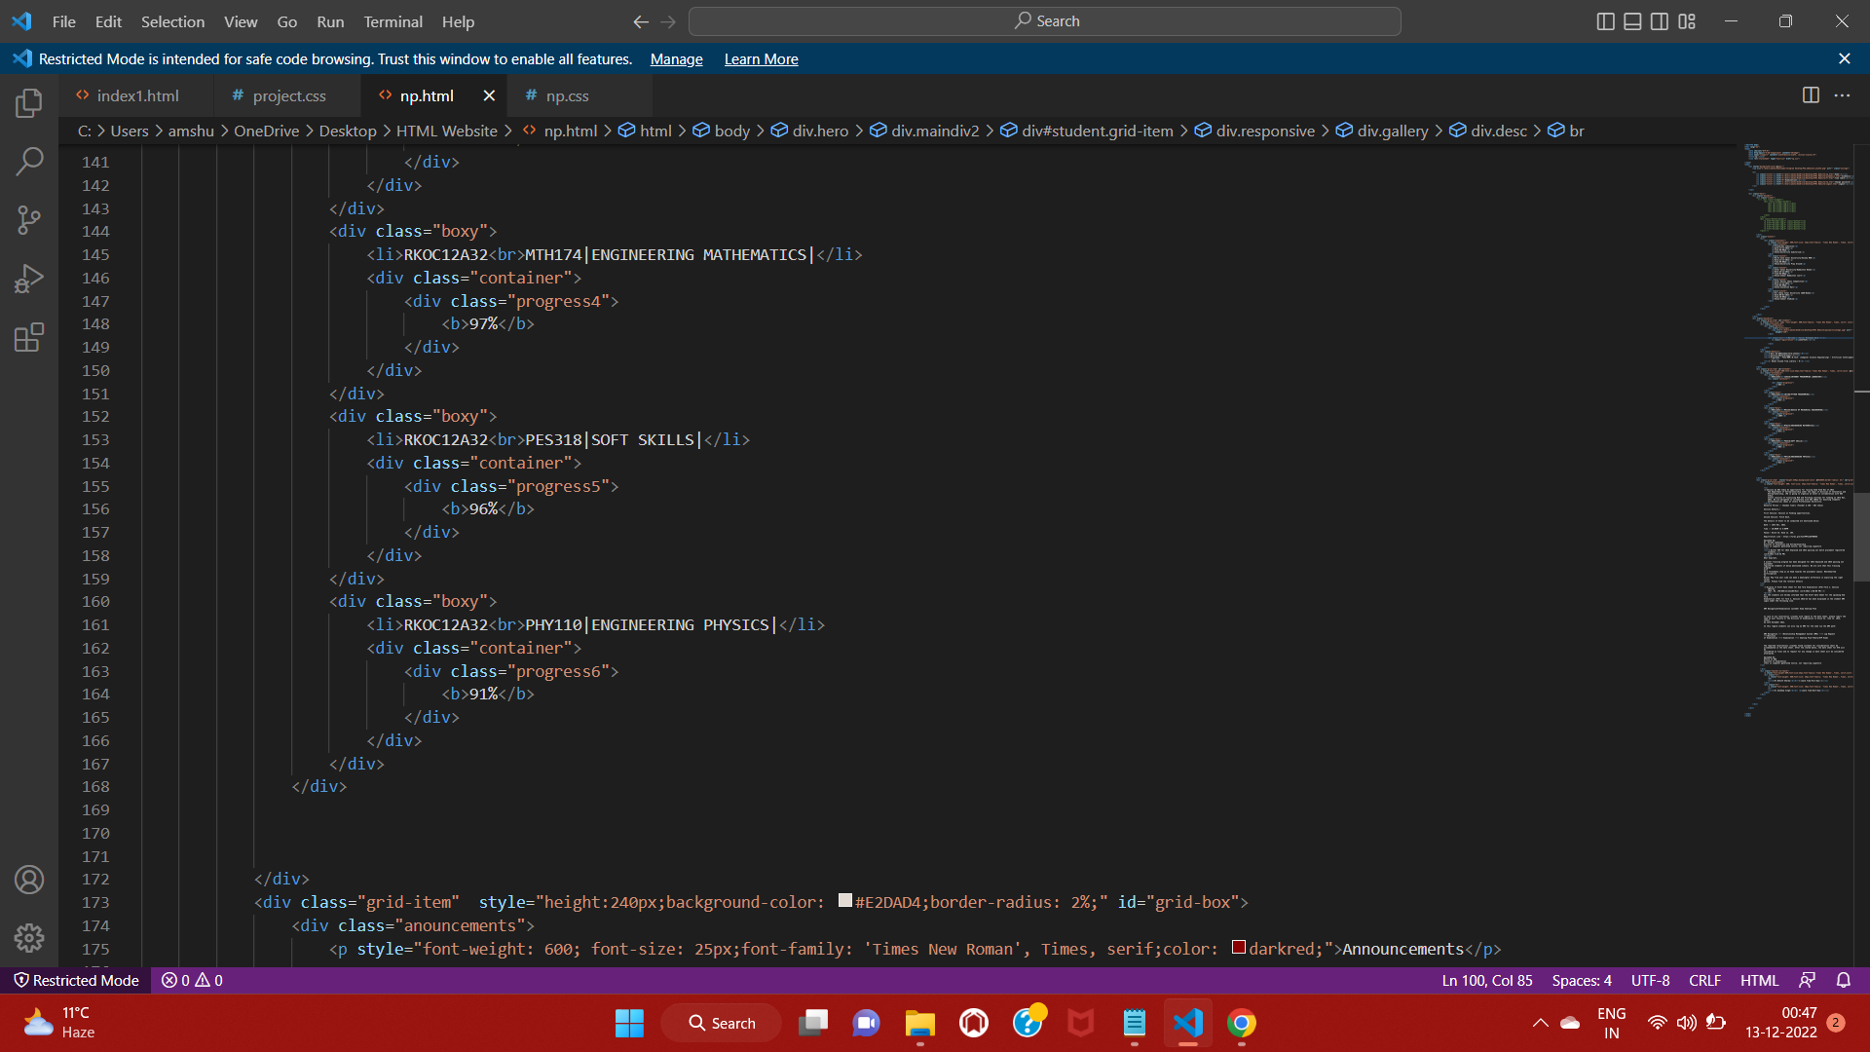

Slide 21
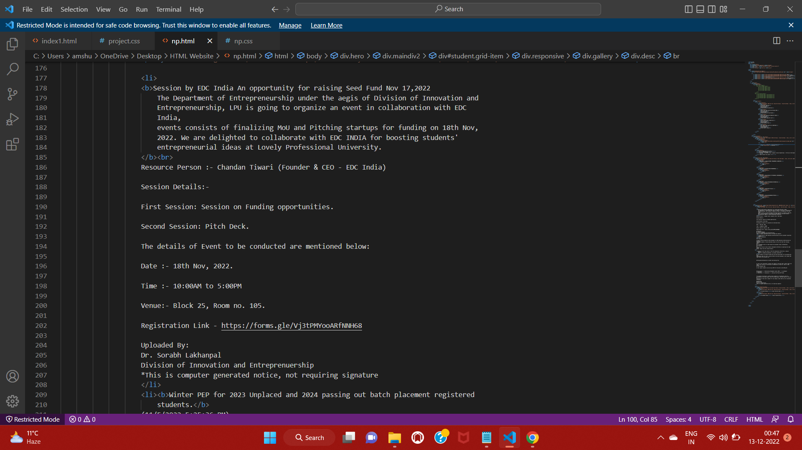

Slide 22
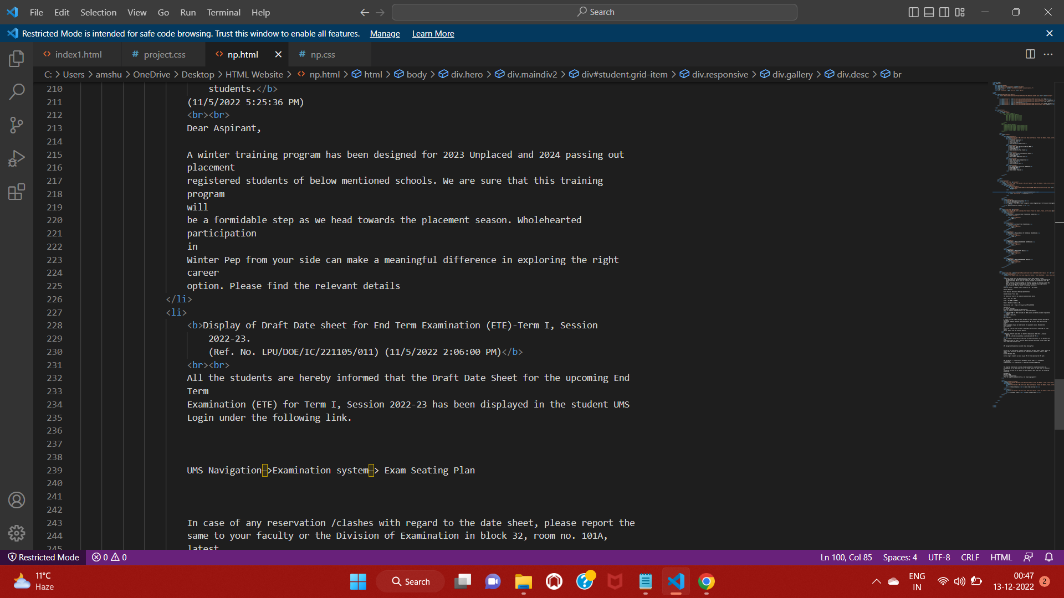

Slide 23
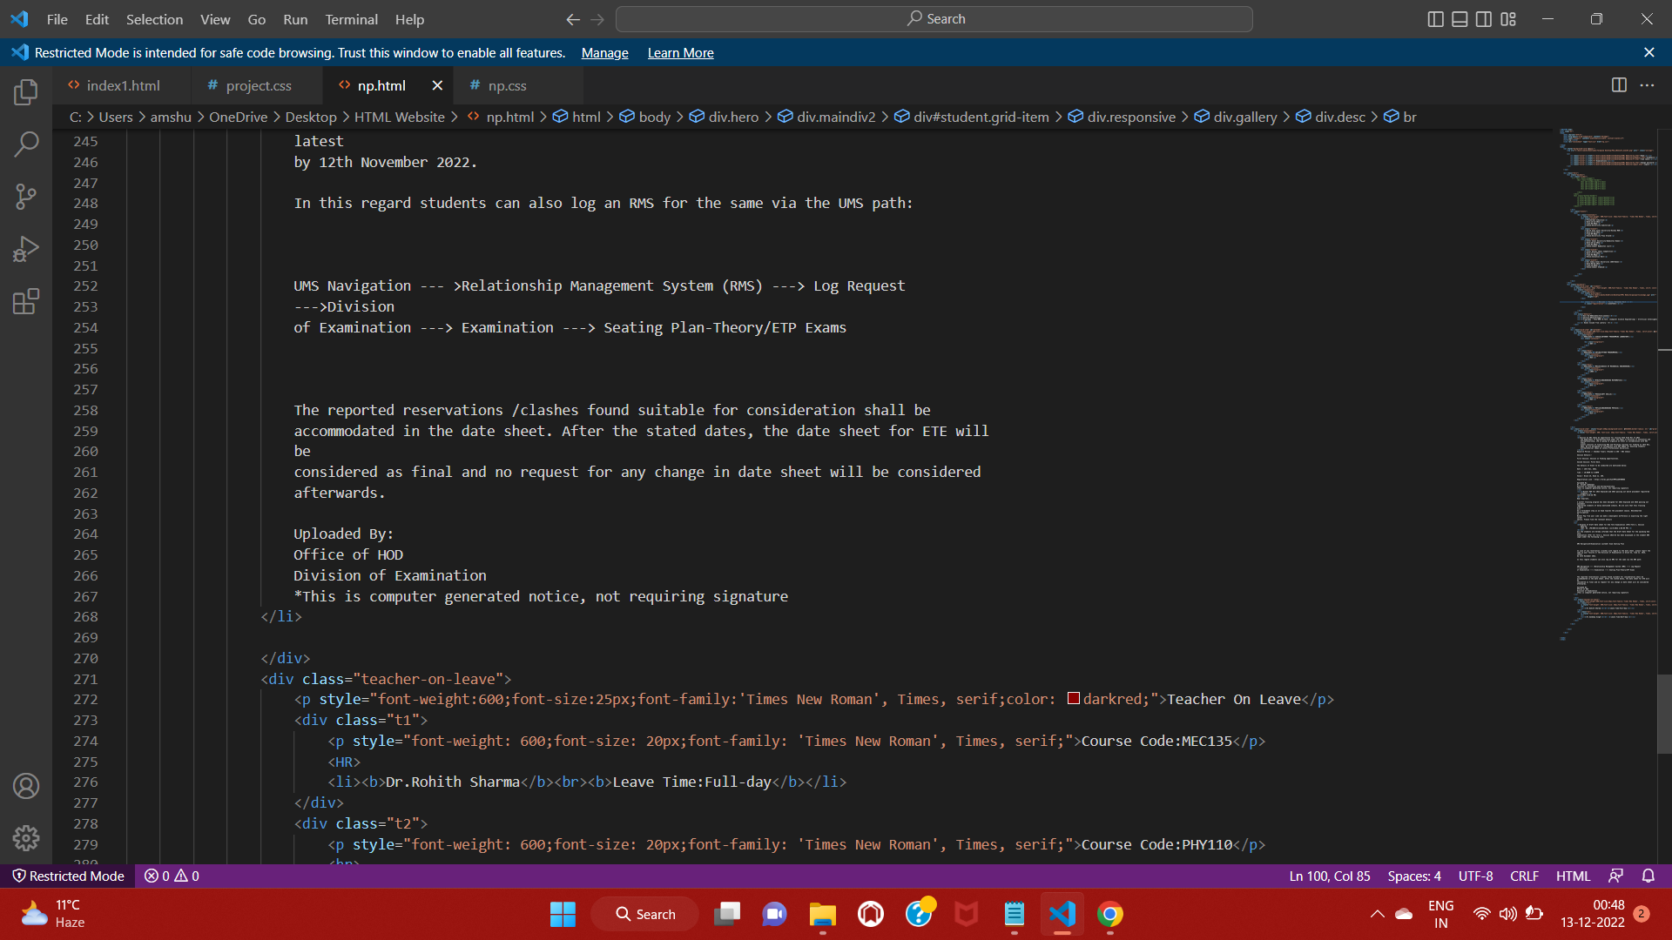

Slide 24
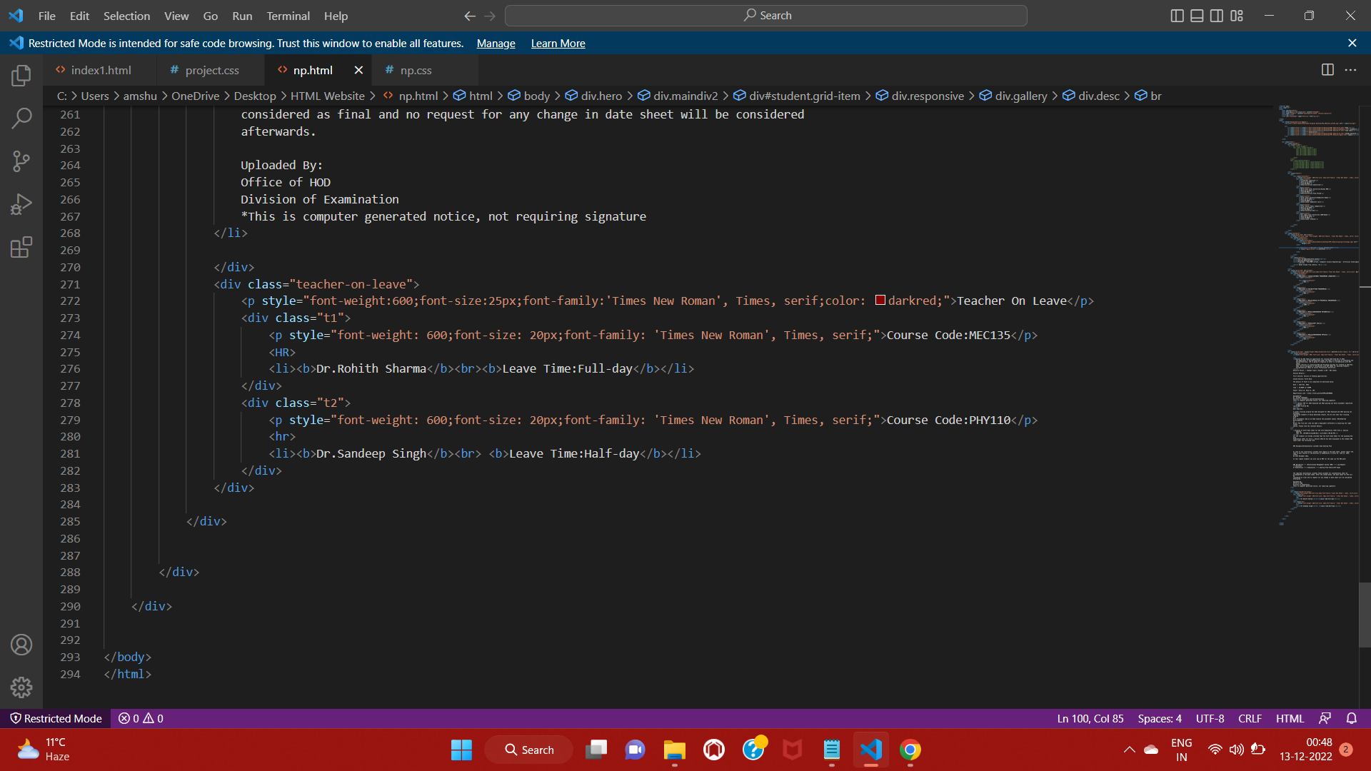

Slide 25
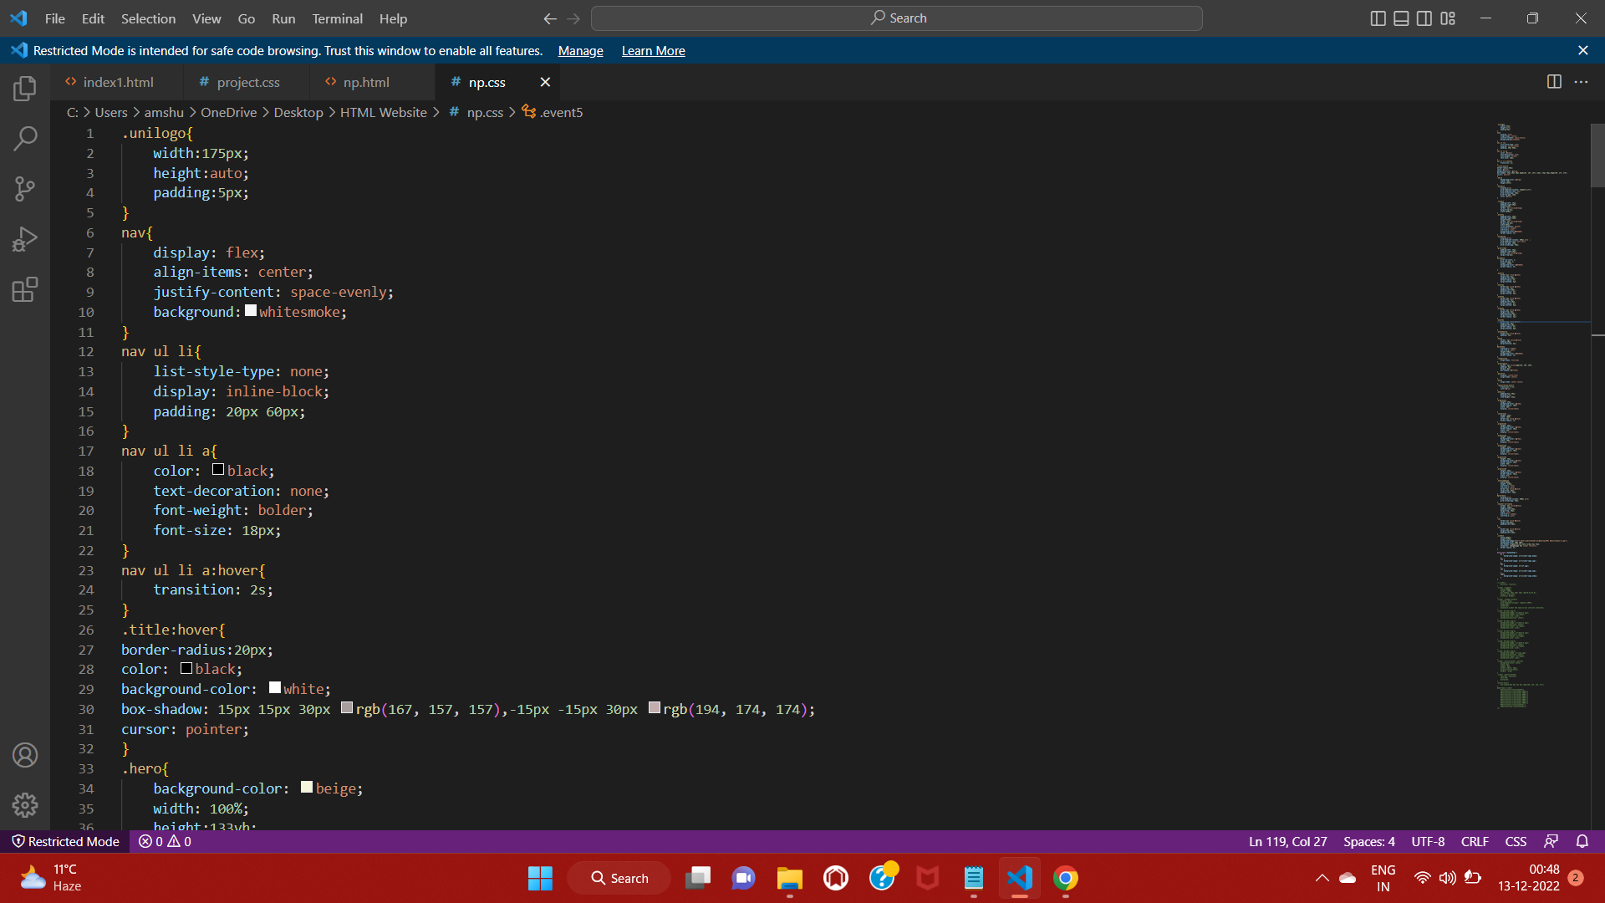

Slide 26
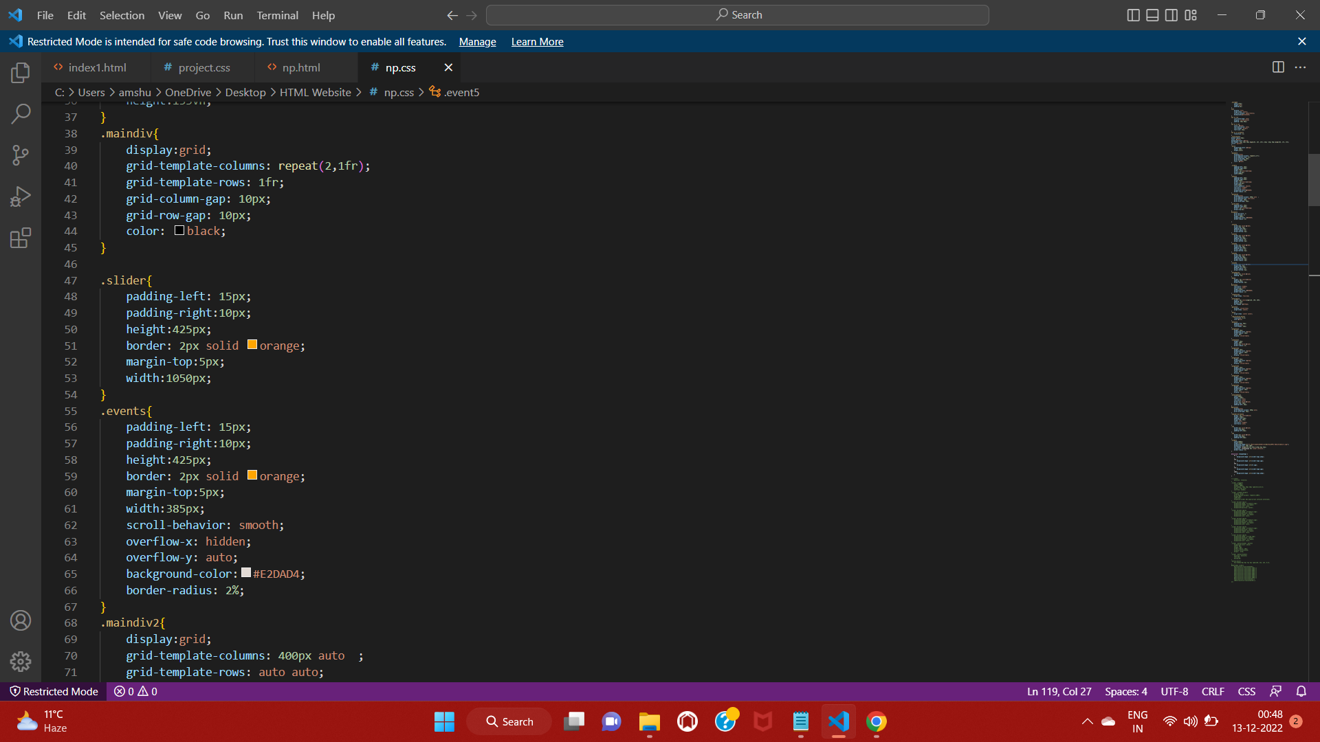

Slide 27
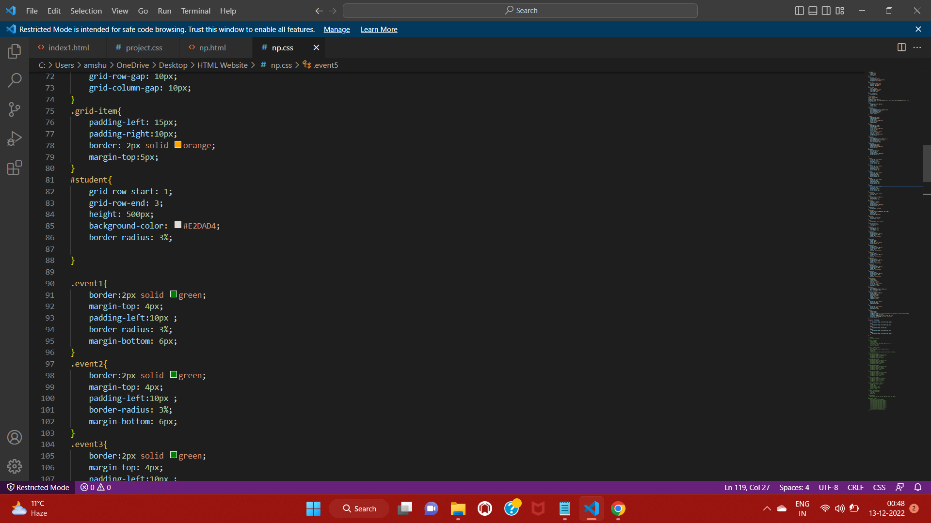

Slide 28
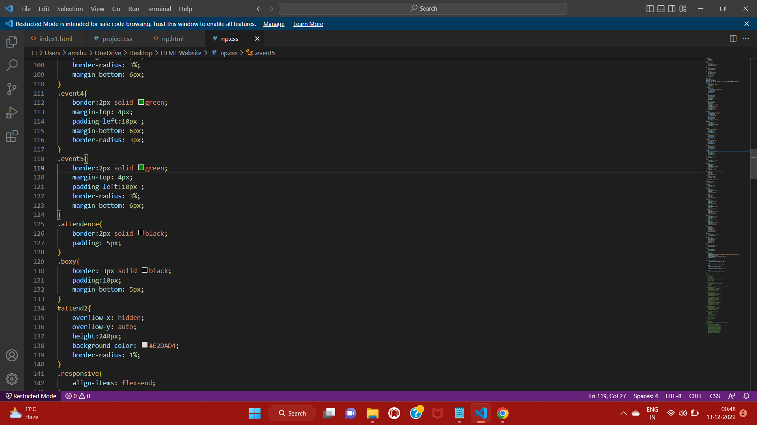

Slide 29
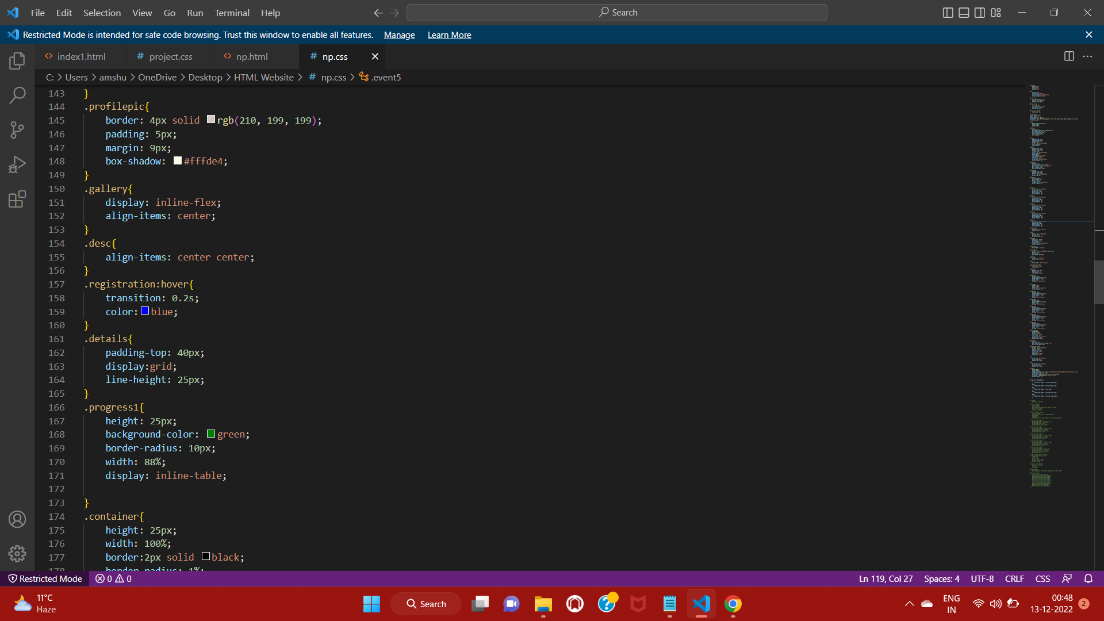

Slide 30
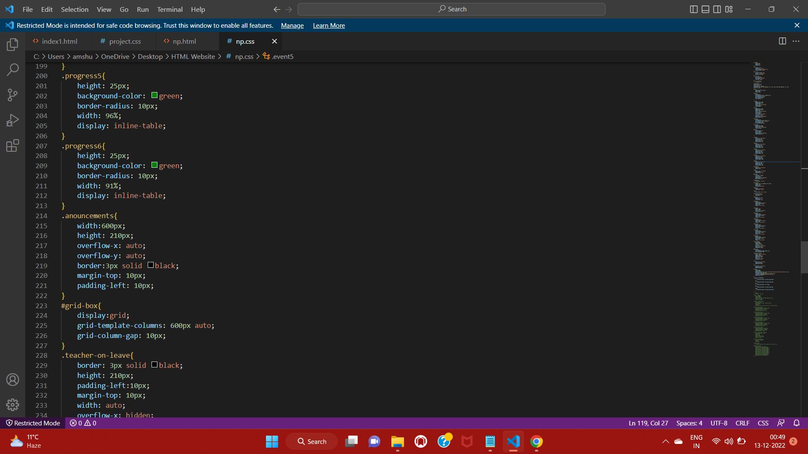

Slide 31
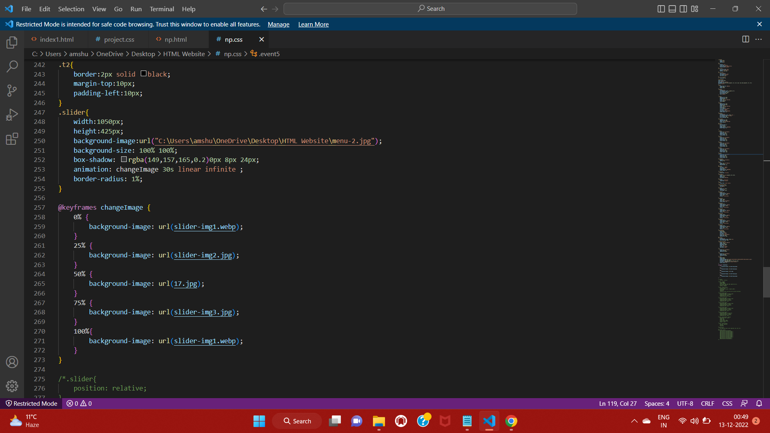

Slide 32
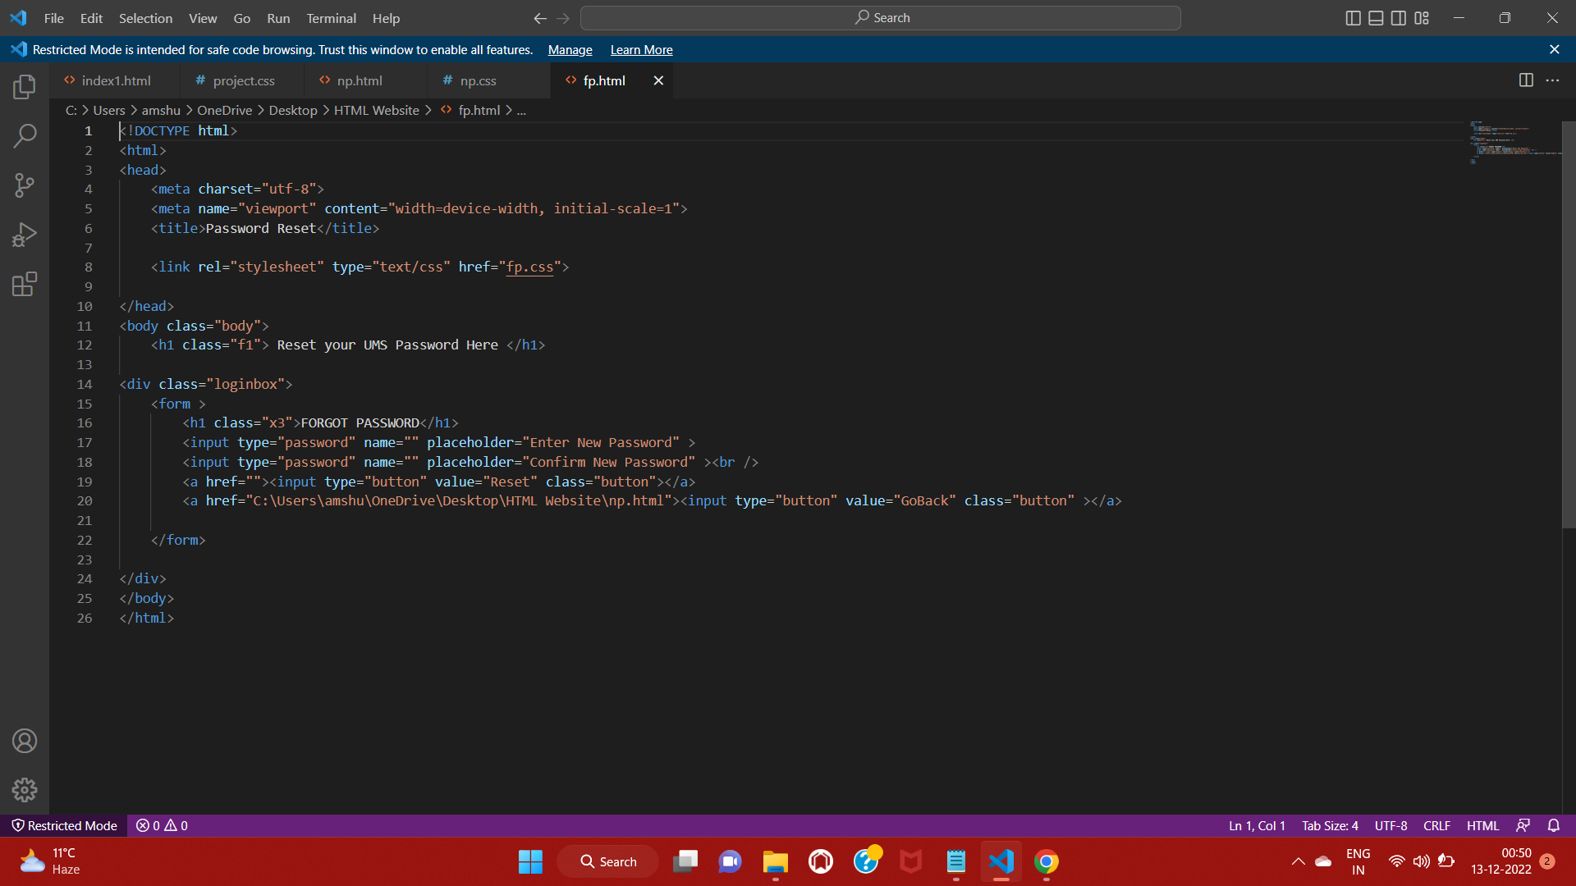

Slide 33
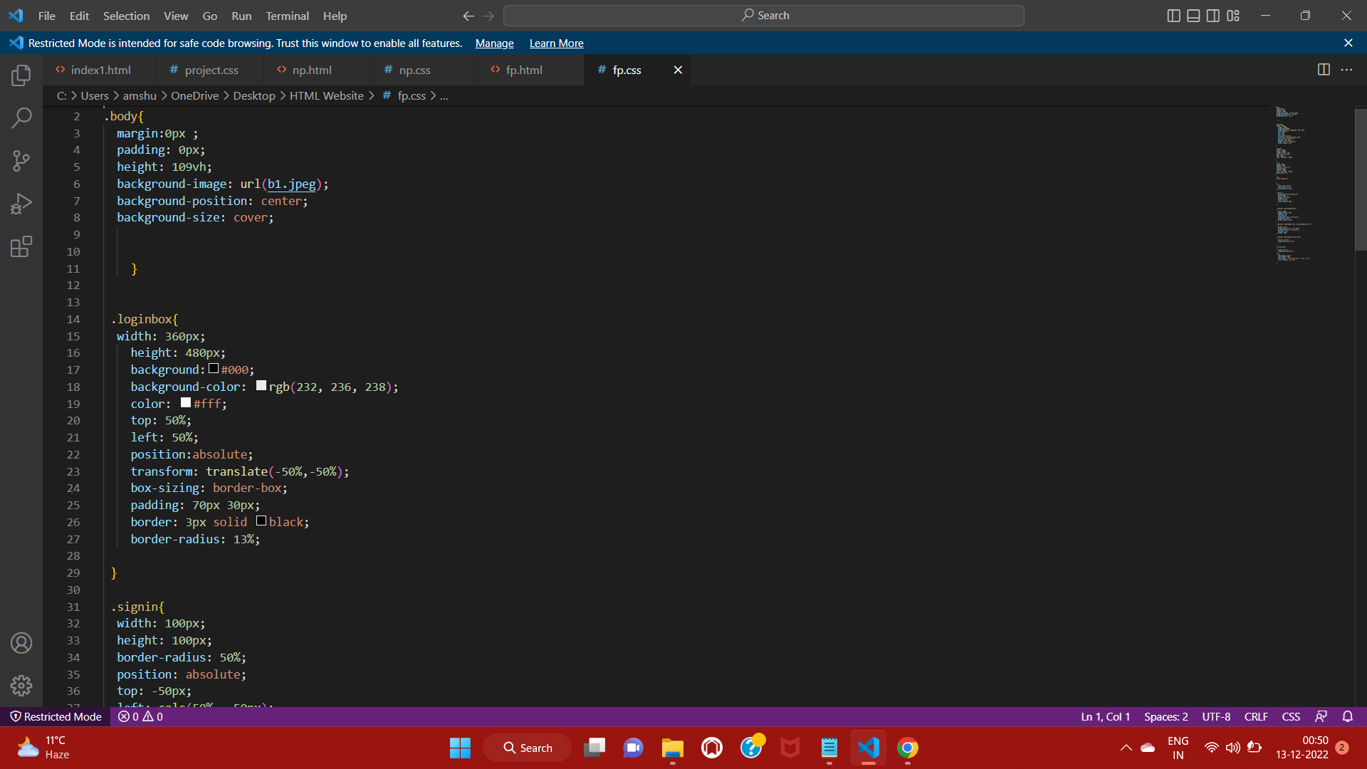

Slide 34
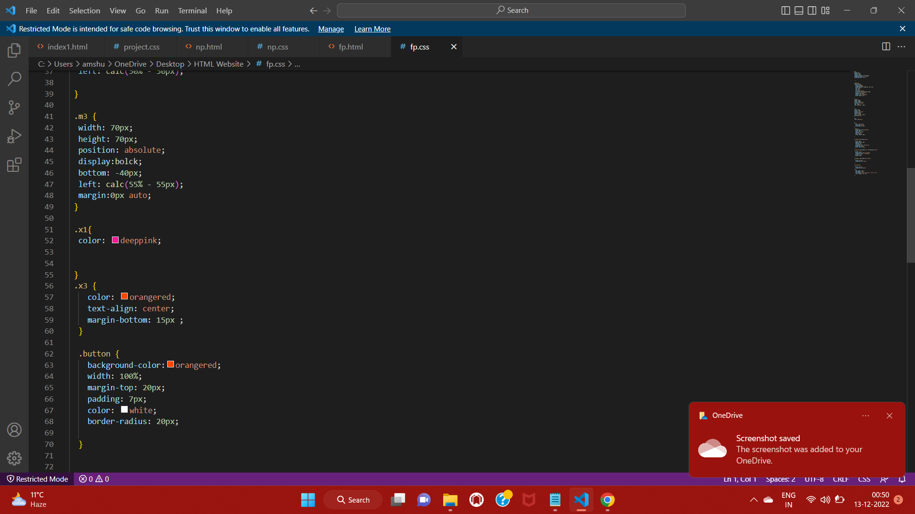

Slide 35
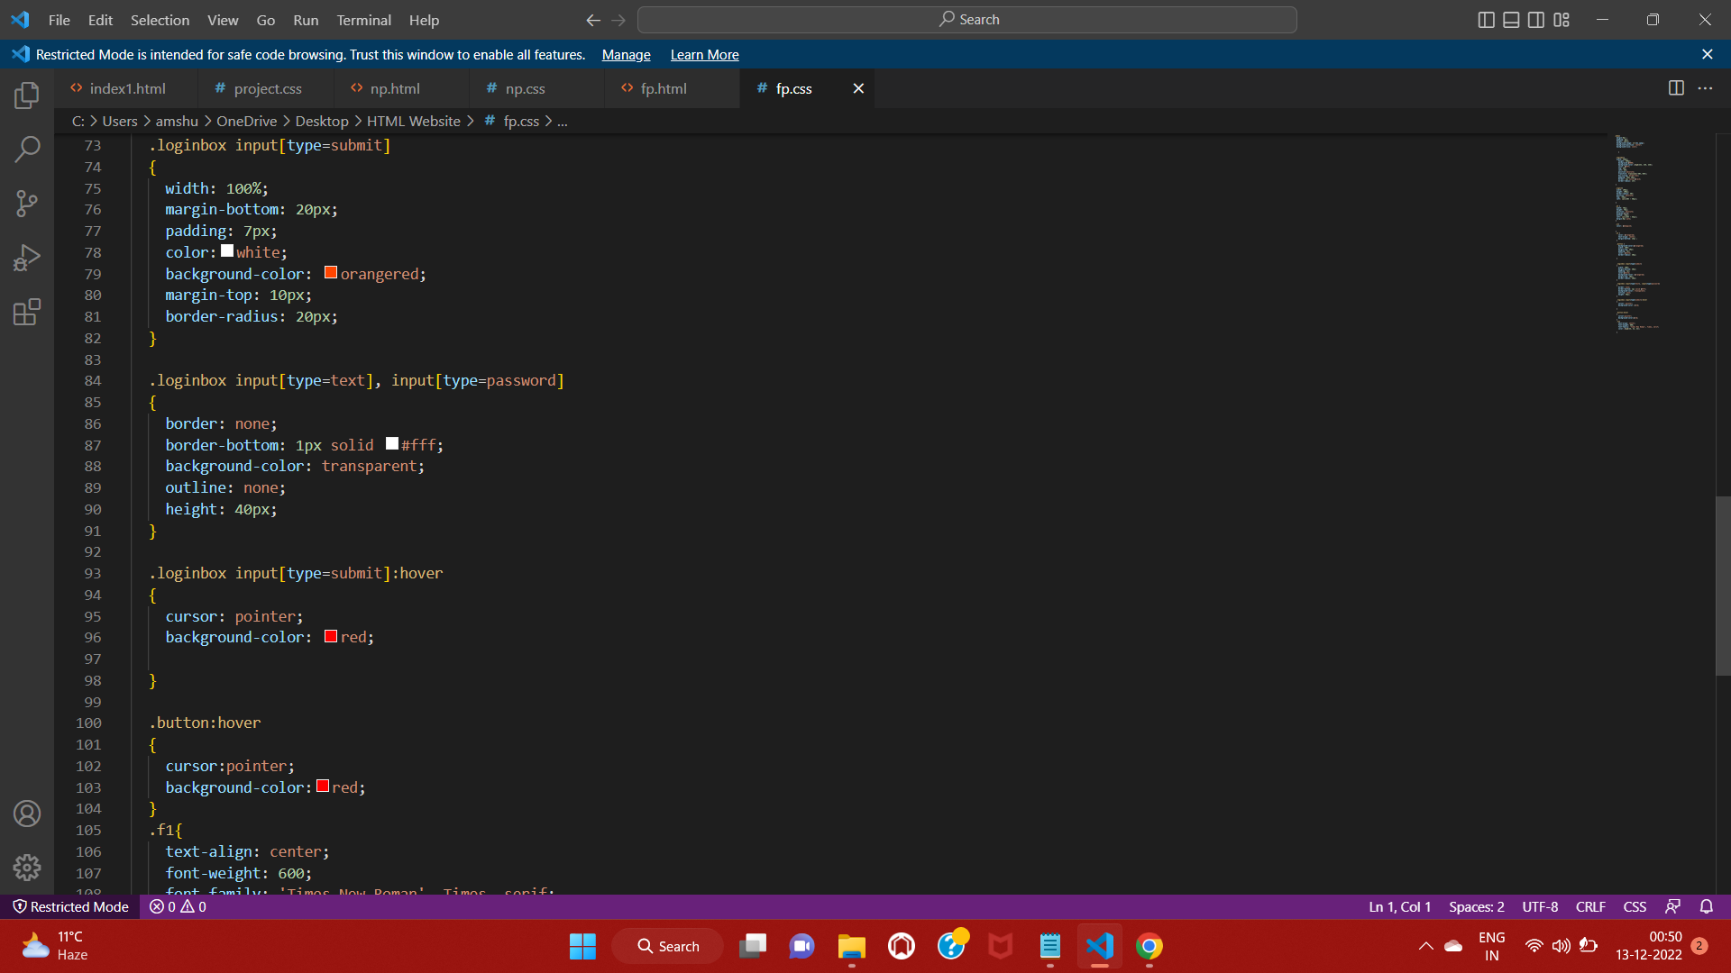

Slide 36
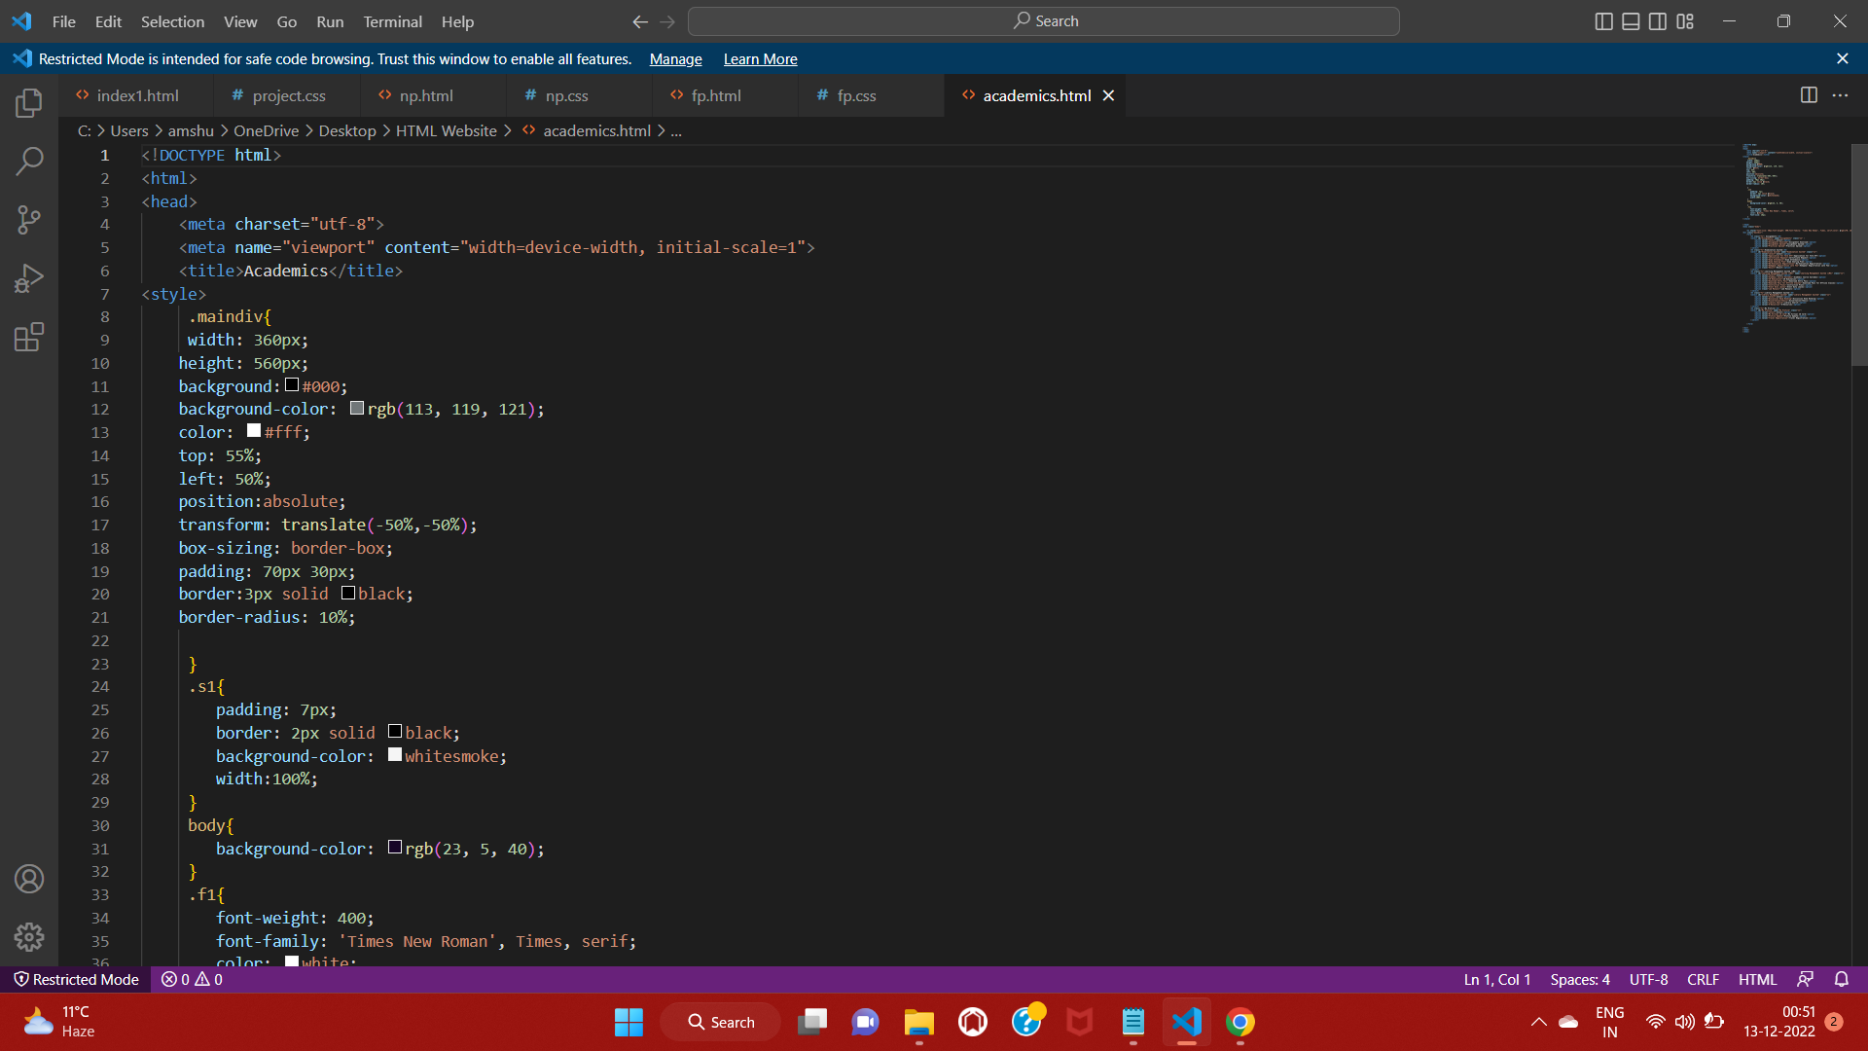

Slide 37
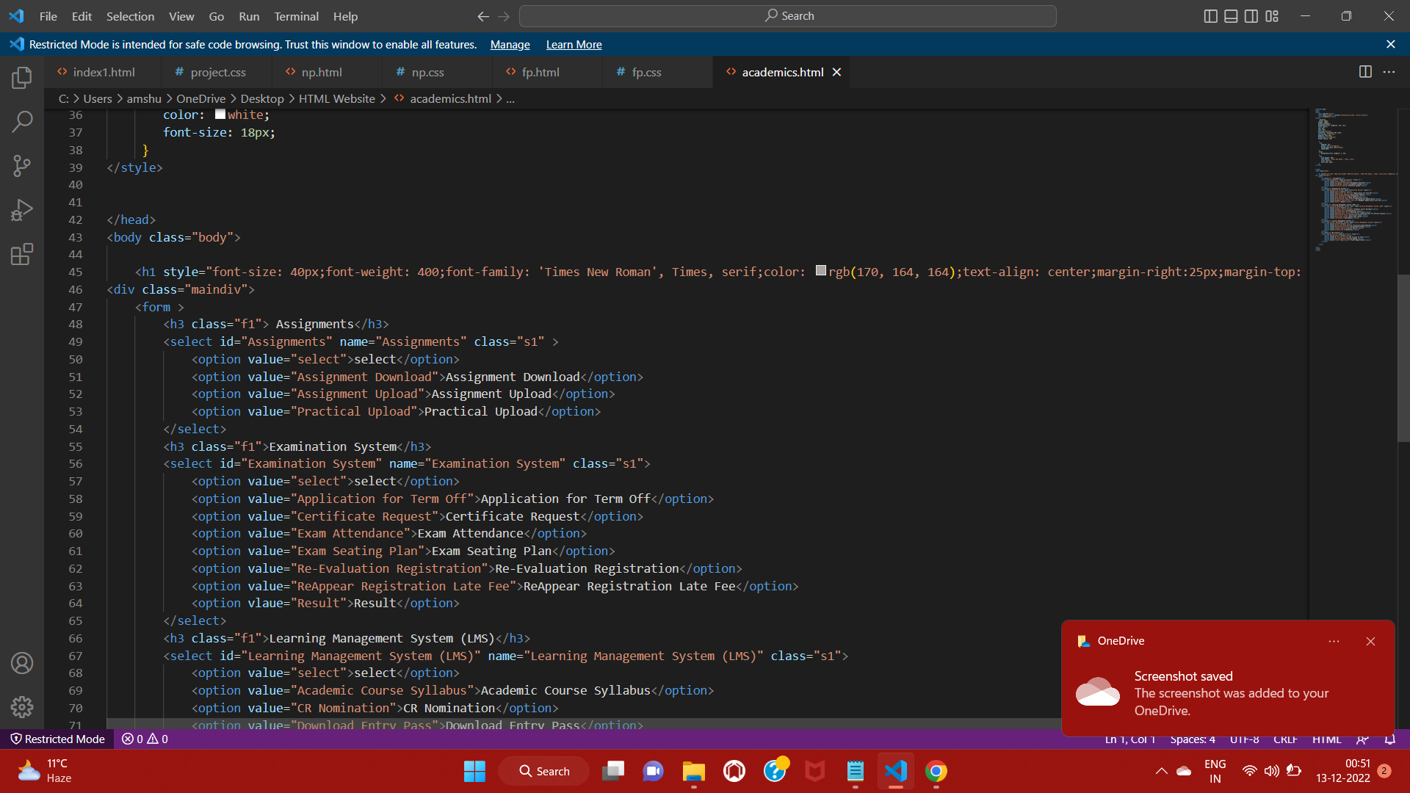
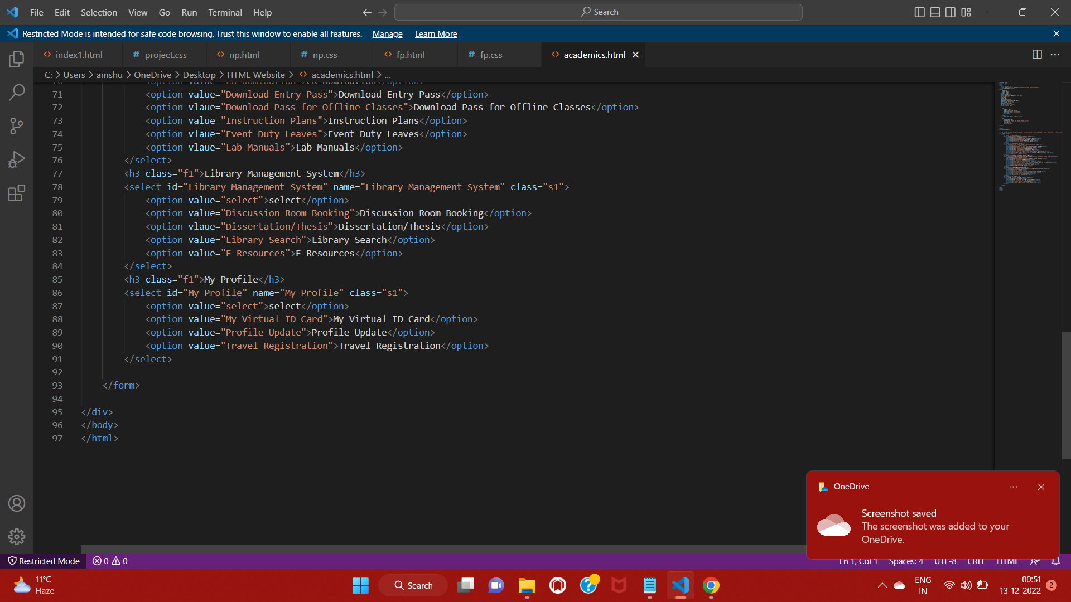

Slide 39
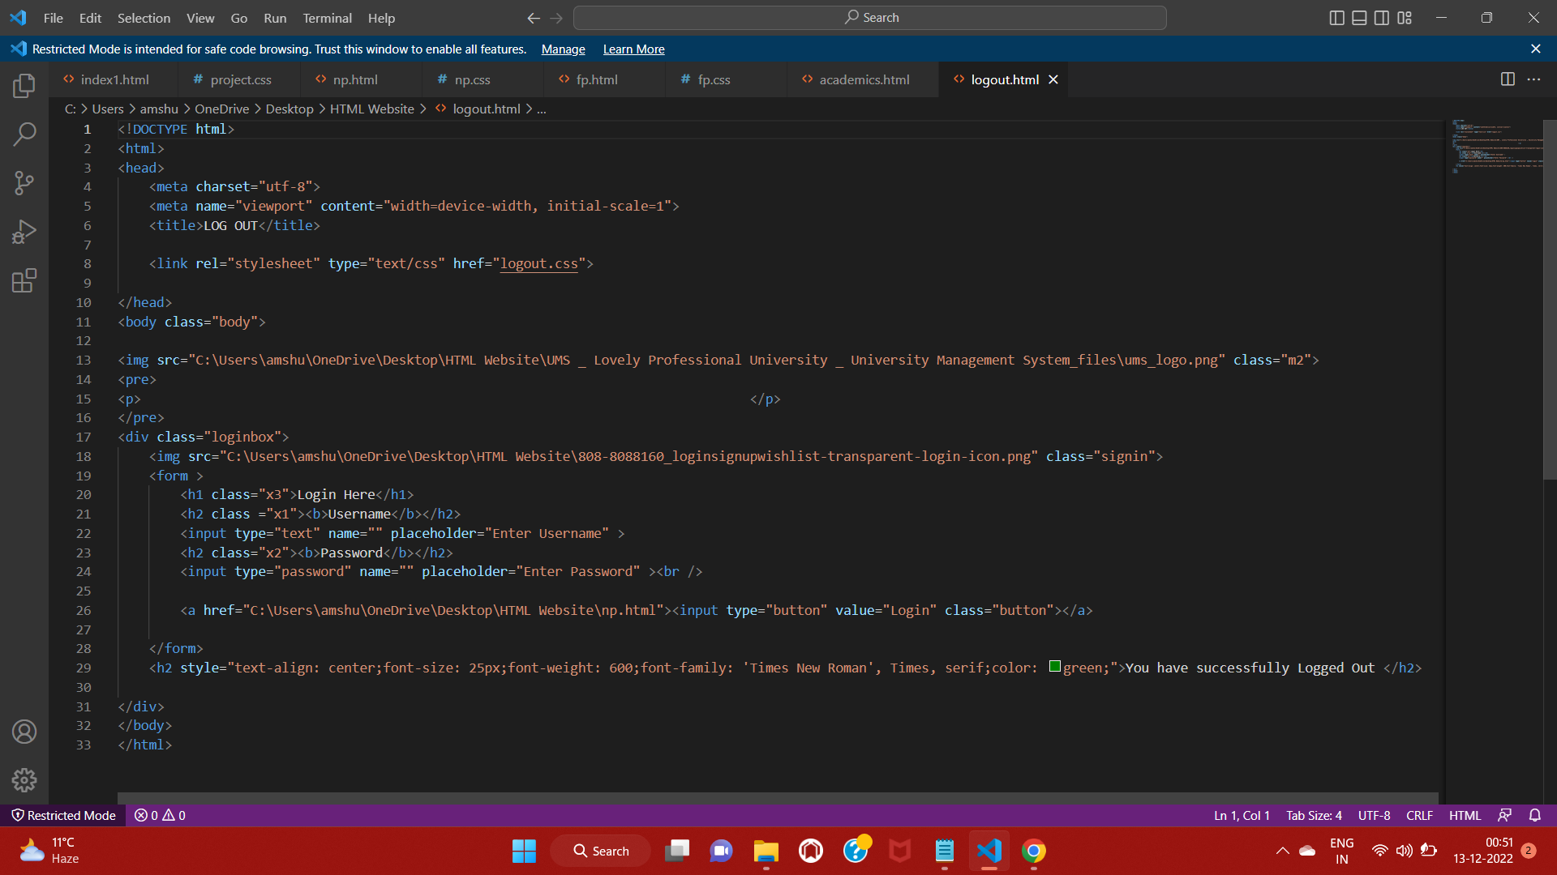

Slide 40
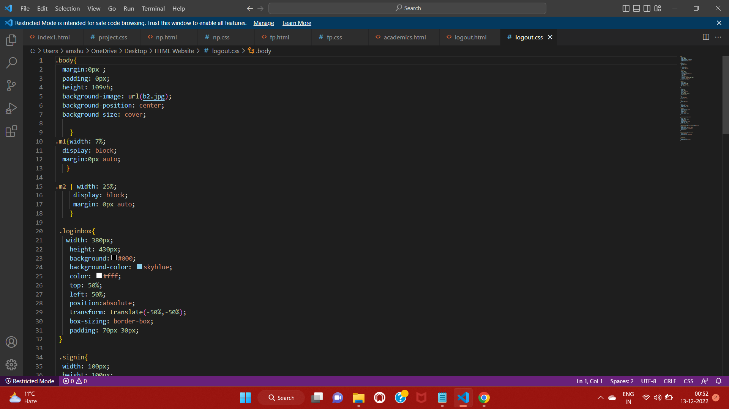

Slide 41
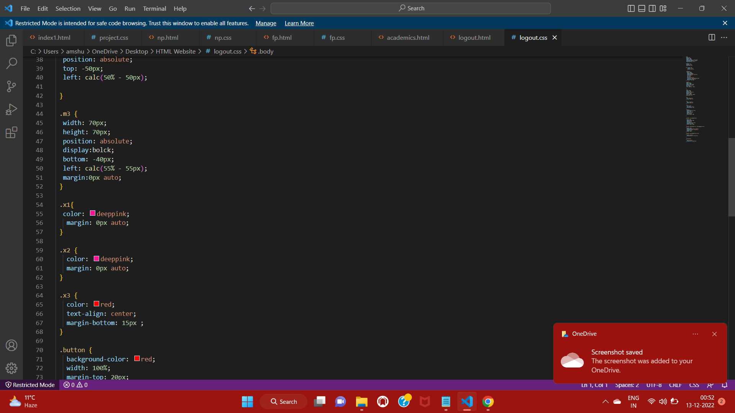

Slide 42
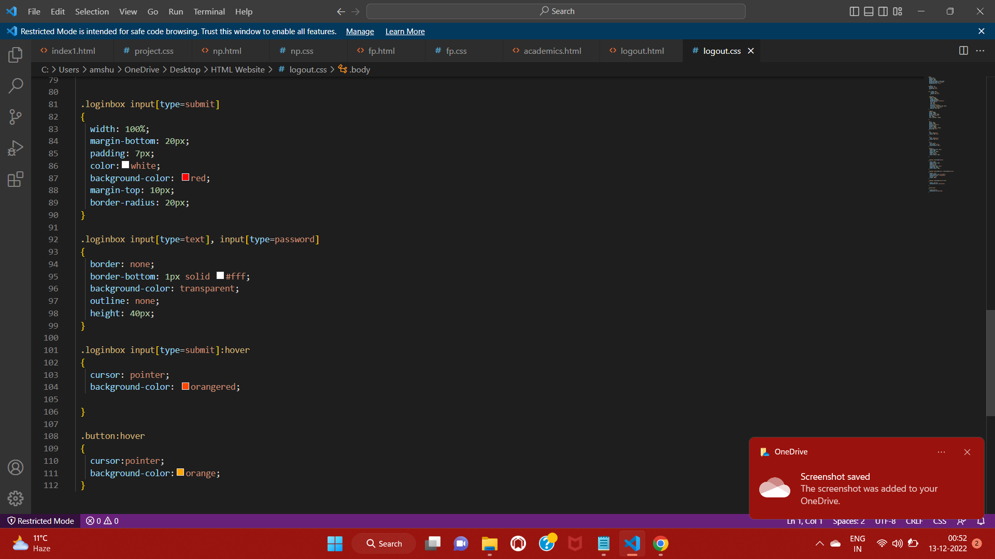

Slide 43
THANK YOU

